Slide 1
DECISION TREE
PRESENTED BY :
ANIL M A

Slide 2
CONTENTS
Introduction to Decision Tree algorithm
Classification and Regression Trees
Decision Tree algorithm terminology
Decision Tree algorithm intuition
Overfitting in Decision-Tree algorithm
Import libraries
Import dataset
Exploratory data analysis
Declare feature vector and target variable
Split data into separate training and test set
Feature engineering
Decision Tree classifier with criterion gini-index
Decision Tree classifier with criterion entropy
Confusion matrix
Results and conclusion
References

Slide 3
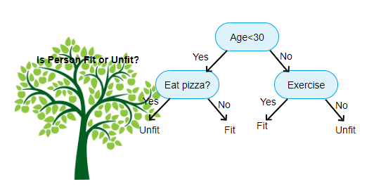
About Decision Tree
Decision tree are a non-parametric supervised learning method used for classification and regression. The goal is to create a model that predicts the value of a target variable by learning simple decision rules inferred from the data features.

Slide 4
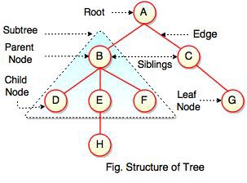
Decision tree algorithm terminology
1.Root node
2.Splitting
3.Decision node
4.Leaf/Terminal node
5.Pruning
6.Branch/Sub tree
7.Parent and Child node

Slide 5
Decision Tree algorithm intuition
For each attribute in the dataset, the Decision-Tree algorithm forms a node. The most important attribute is placed at the root node.
For evaluating the task in hand, we start at the root node and we work our way down the tree by following the corresponding node that meets our condition or decision.
This process continues until a leaf node is reached. It contains the prediction or the outcome of the Decision Tree.

Slide 6
Overfitting in Decision Tree algorithm
Overfitting is a practical problem while building a Decision-Tree model. The problem of overfitting is considered when the algorithm continues to go deeper and deeper to reduce the training-set error but results with an increased test-set error. So, accuracy of prediction for our model goes down. It generally happens when we build many branches due to outliers and irregularities in data.
Pre-Pruning-
In pre-pruning, we stop the tree construction a bit early. We prefer not to split a node if its goodness measure is below a threshold value. But it is difficult to choose an appropriate stopping point.
Post-Pruning-
In post-pruning, we go deeper and deeper in the tree to build a complete tree. If the tree shows the overfitting problem then pruning is done as a post-pruning step. We use the cross-validation data to check the effect of our pruning. Using cross-validation data, we test whether expanding a node will result in improve or not.

Slide 7
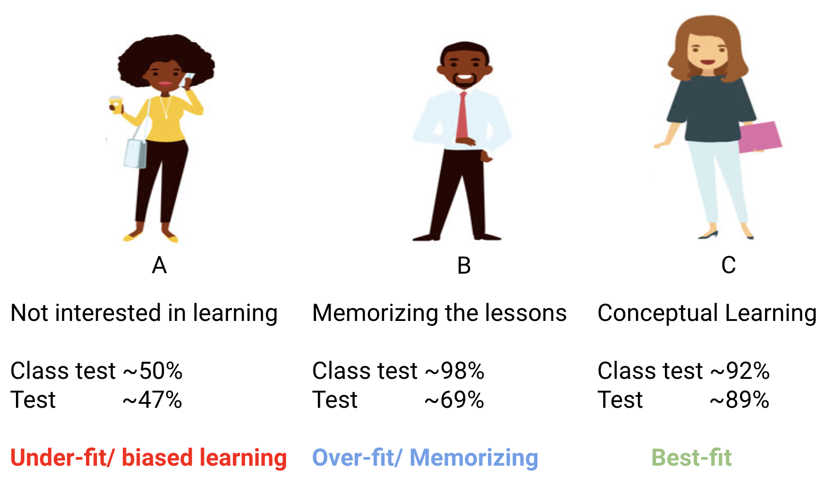

Slide 8
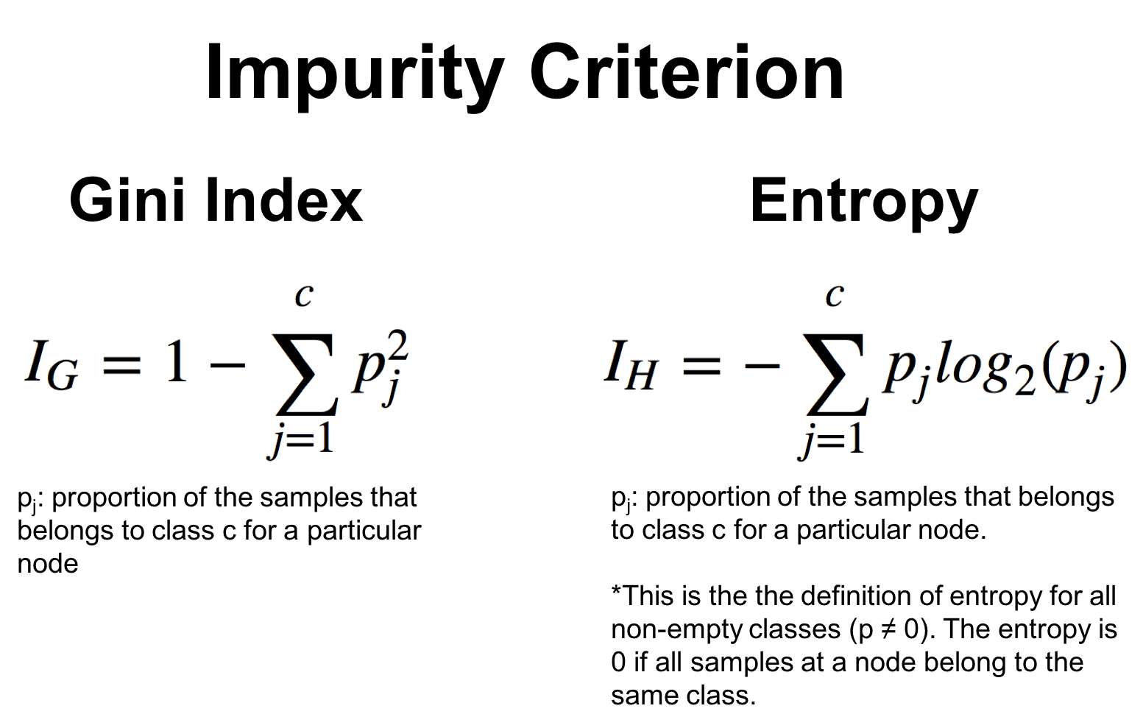
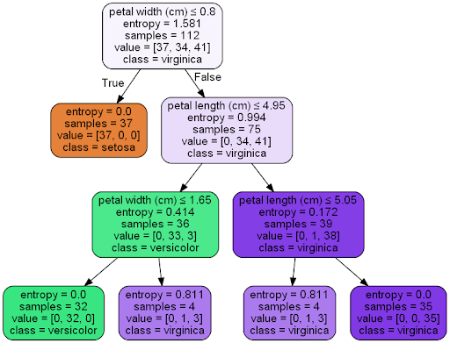
Attribute selection measures
1.Gini index -Favors larger partitions and easy to implement.
2.Information gain.
Entropy-Entropy measures the impurity in the given dataset.

Slide 9
Steps involved-
Import libraries and Datasets
Exploratory data analysis
Declare feature vector and target variable
Split data into separate training and test set
Feature engineering
Decision Tree classifier with criterion gini-index
Decision Tree classifier with criterion entropy
Confusion matrix
Classification report

Slide 10
Advantages-
Clear Visualization
handle missing values.
Less Training Period
Simple and easy to understand
Disadvantages-
Overfitting
Unstable
Affected by noise
Not suitable for large datasets

Slide 11
Applications-
In finance for option pricing
In banks to classify loan applicants
Healthcare
Agriculture
Buisness management ,etc

Slide 12
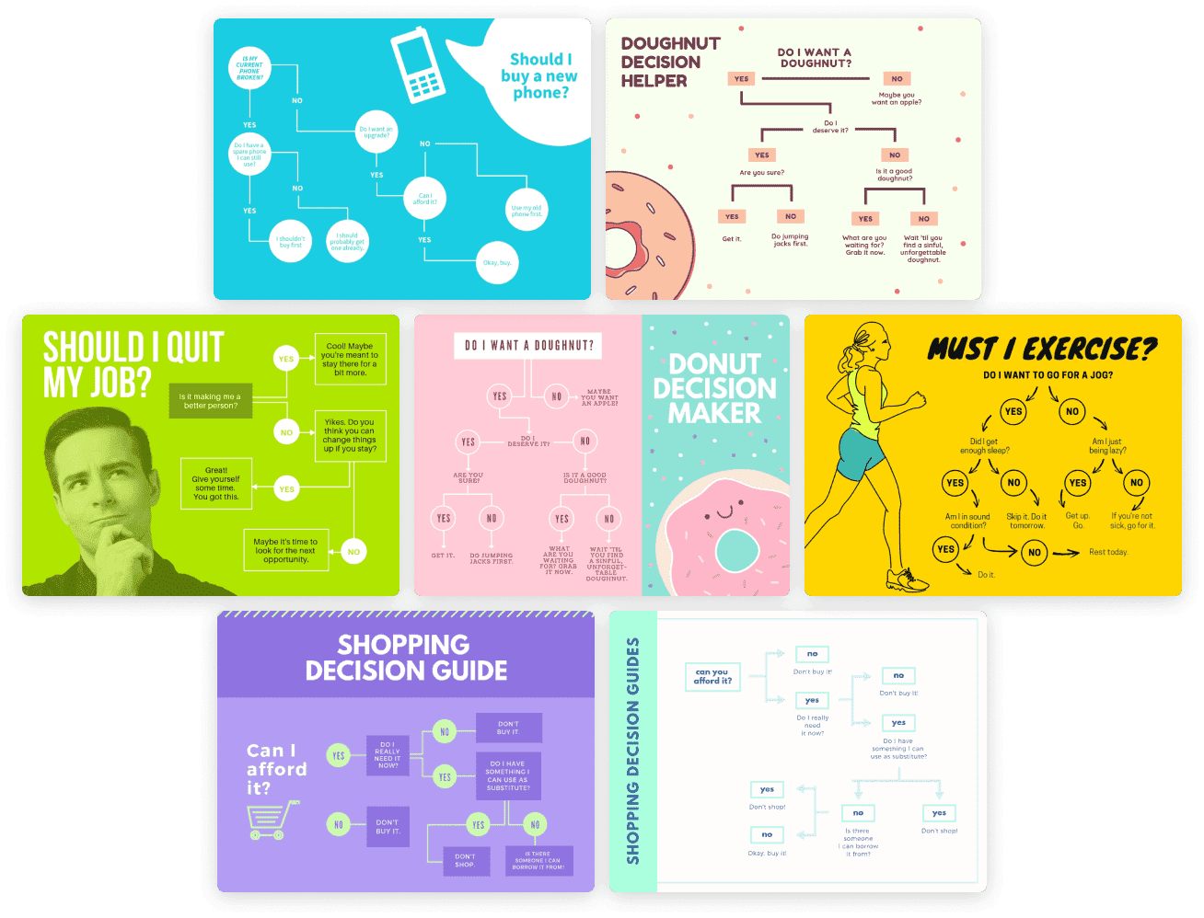

Slide 13
CONCLUSION
In this project, I build a Decision-Tree Classifier model to predict the Drug type for future reference if a person has similar kind of disease. The model yields a very good performance as indicated by the model accuracy in the case which was found to be 0.98.
The confusion matrix and classification report yields very good model performance.

Slide 14
Reference
The work done in this project is inspired from following books and websites:-
Hands on Machine Learning with Scikit-Learn and Tensorflow by Aurélién Géron
Introduction to Machine Learning with Python by Andreas C. Müller and Sarah Guido
https://en.wikipedia.org/wiki/Decision_tree
https://en.wikipedia.org/wiki/Information_gain_in_decision_trees
https://en.wikipedia.org/wiki/Entropy_(information_theory)
https://www.datacamp.com/community/tutorials/decision-tree-classification-python
https://stackabuse.com/decision-trees-in-python-with-scikit-learn/
https://www.kaggle.com/prashant111/decision-tree-classifier-tutorial

Slide 15
“Anyone who stops learning is old, whether at twenty or eighty. Anyone who keeps learning stays young.” – Henry Ford

Slide 16
Thank you

